Slide 1

Predicting Breast Cancer Diagnosis in Masses
Caitlin Styles, Sharon Romero, Robert Ford
Notes:
Breast cancer is the second most common cancer in the world and early detection is the most important factor in successful treatment and survival. For many years, medical researchers have attempted to improve breast cancer diagnosis and management. Tumor measurement has been identified as one of the best early predictors of the disease. In this presentation, we will statistically explore the value of tumor measurements and present correlations and regression models that might best help in early prediction of breast cancer.

Slide 2

Research Problem and Objective
Background. Masses in the breast can be either Benign and Malignant. Malignant = Cancer
Problem. Untreated malignant mass (false negative) can lead to death. Treatment of a benign mass (false positive) should be avoided.
Goal: Build a model to diagnose masses as either benign or malignant.
Notes:
A detected mass is diagnosed as either benign or malignant. Both diagnoses would have follow-ups and monitoring; a malignant diagnosis leads to treatment.
Accurate diagnosis is very important as an untreated malignant mass (false negative) can lead to death. Treatment can be expensive so a treated benign mass (false positive) can be costly too.
Goal: Using mass measurements, build a model that will accurately diagnose masses as either benign or malignant.

Slide 3

Data Description
ID | Radius_mean | Radius_se | Radius_worst
Diagnosis | Texture_mean | Texture_se | Texture_worst
 | Perimeter_mean | Perimeter_se | Perimeter_worst
 | Area_mean | Area_se | Area_worst
 | Smoothness_mean | Smoothness_se | Smoothness_worst
 | Compactness_mean | Compactness_se | Compactness_worst
 | Concavity_mean | Concavity_se | Concavity_worst
 | Concave_Points_mean | Concave_Points_se | Concave_Points_worst
 | Symmetry_mean | Symmetry_se | Symmetry_worst
 | Fractal_Dimension_mean | Fractal_Dimension_se | Fractal_Dimension_worst
Original dataset: 32 attributes; 569 records.
Independent Variables: continuous measurements.
Dependent Variable: diagnosis of benign or malignant.
Notes:
The original dataset is comprised of 32 attributes, and 569 records. The 569 records represent three statistical summary measures from a larger group of separate mass measurements. We’ll later discuss which attributes were dropped from the models.
All of the variables displayed in the table to the right show a measurement location followed by an underscore and the statistical summary measure type. There are 10 different measurement locations and 3 different measurement types. For measurement locations we have Radius, Texture, Perimeter, Area, Smoothness, Compactness, Concavity, Concave Points, Symmetry, and Fractal Dimension. For measurement types, we have the mean, the standard error of the summary measures of each data set by row, as early mentioned, and the worst measurement recorded in the data set by row.

Slide 4
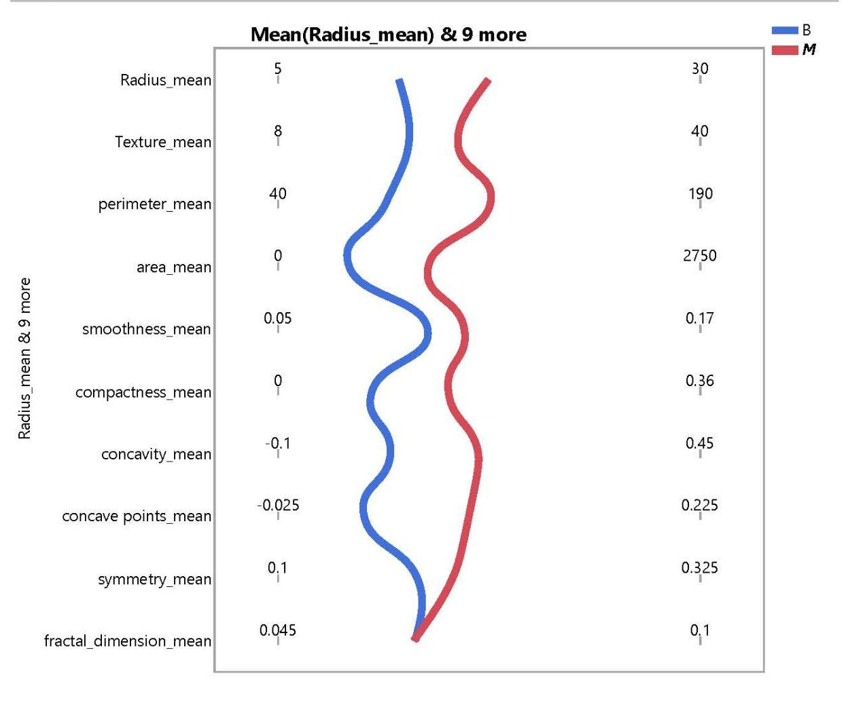

Data Description
Distribution of mean variables; benign vs malignant.
Notes:
Prior to developing a statistical model capable of accurately predicting, based on measurements, whether a mass in the breast is either malignant or benign, we contrasted the mean measurements of the data set separated by diagnosis. The chart to the right shows that there is a degree of correlation between mean measurements with a malignant diagnosis and mean measurements with a benign diagnosis. With initial data proving a correlation, we began to further investigate statistical models to determine applicability of the independent variables.

Slide 5


Data Preparation
No outliers removed
13 missing values in concave_points_mean; JMP’s data imputation function was used
Removed standard error attributes.
Notes:
The data preparation consisted of two steps. The first was to ensure no significant outliers existed. Based on the goal of the model of predicting cancer to save someones life, all measurements were deemed relevant.
13 missing values were identified in the concave_points_mean measurement. JMP’s imputation function was used to insert estimated values.

Slide 6
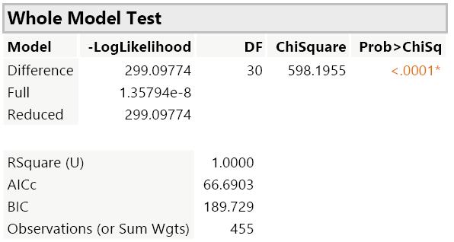
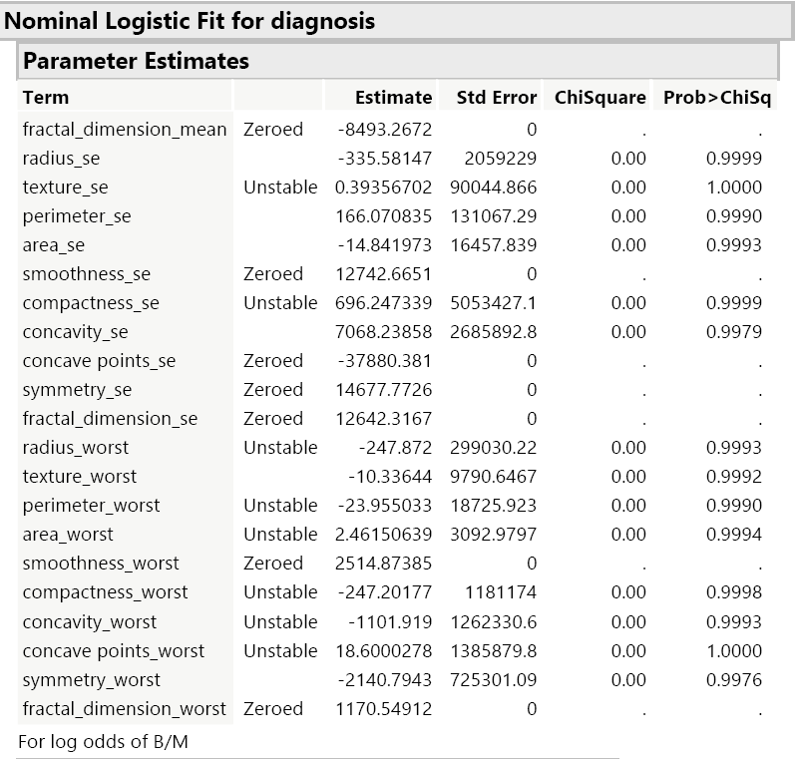

Initial Baseline Model
Initial Logistic regression model - 30 variables
High R^2 value (1.0000)
The Parameter Estimates don’t have values for some variables.
Standard Error variables not used in subsequent models
Notes:
An initial baseline model was created using 30 independent variables, and the diagnosis variable as the target. This model had an R^2 value of 1 with several of the independent variables displaying linear dependencies as denoted by the “Zeroed or Unstable” language displayed in the JMP Parameter Estimates tables. This means that the model is specifying more terms than sufficient degrees of freedom to estimate the results. These independent variables created a model with difficult to interpret results. We determined that, because the standard error variables are not actual measurements of the mass, they should be removed from any subsequent models in order to obtain a more interpretable model. The standard error serves as only a validation of the population or each tuple in the data set. Despite the high R^2 value, having all the variables included was not appropriate.

Slide 7
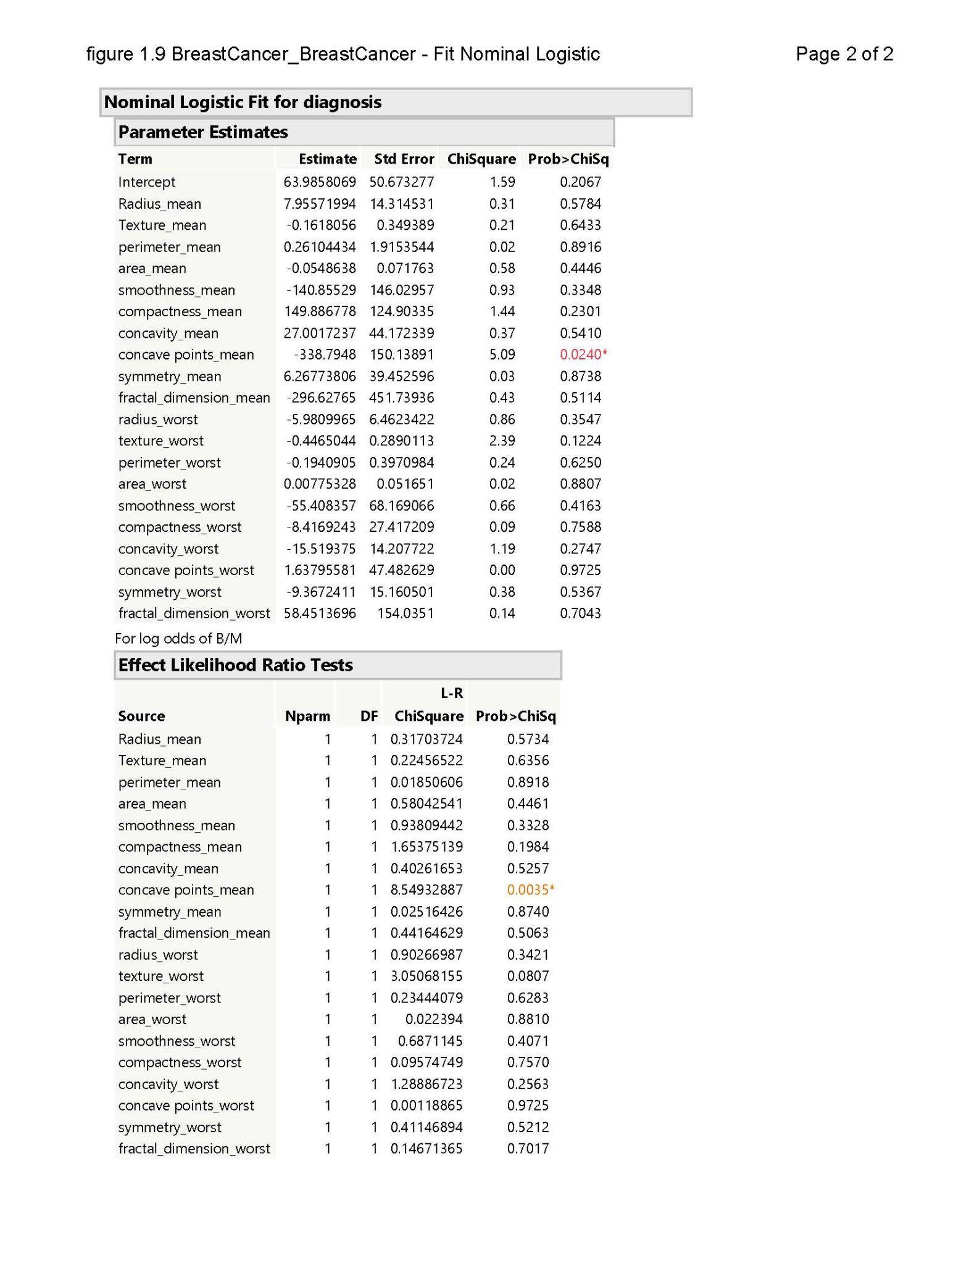
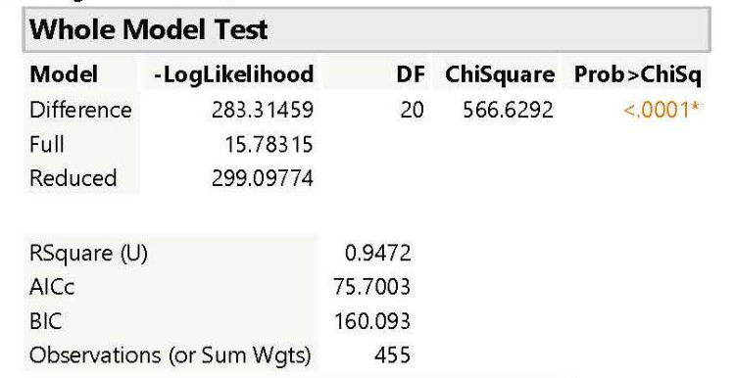

Subsequent Baseline Model
Logistic regression model with 20 variables used: only the “worst” and “mean” measurements
R^2 : 0.947
Notes:
A subsequent baseline model was created with 20 independent variables, removing the standard error variables. The R^2 value decreased but the results were easier to interpret and there were no independent variables displaying linear dependencies as denoted by the “Zeroed or Unstable” language displayed in the JMP Parameter Estimates tables as seen in the model on the previous slide.

Slide 8


Other Models Built
Stepwise Nominal Logistic
Decision Tree
Neural Network
Principal Component Analysis
Notes:
We constructed 4 other statistical models to analyze the best fit to diagnos cancerous tumors. A stepwise nominal logistic, Decision Tree, Neural Network, and Principal Component Analysis.

Slide 9
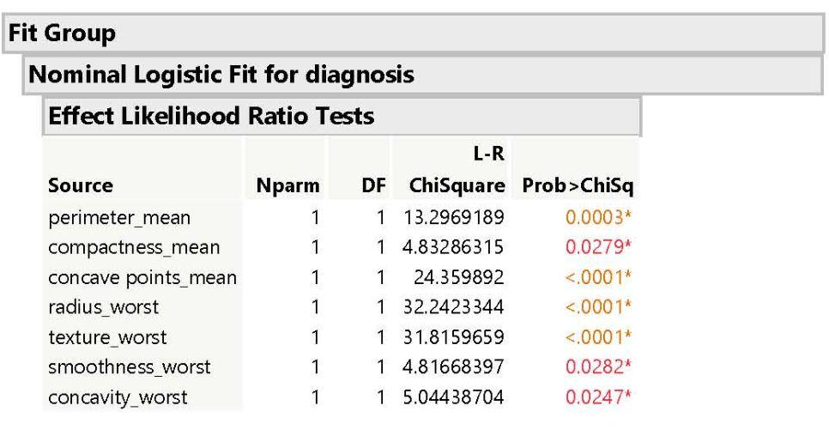
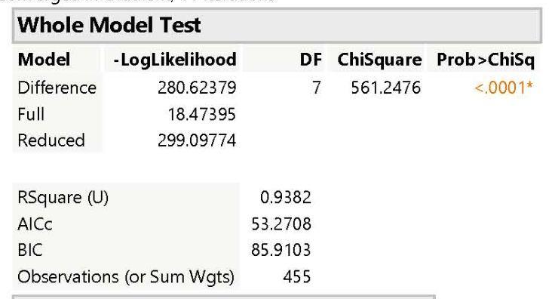

Other Models Built - Results
Stepwise Nominal Logistic
Notes:
In the stepwise nominal logistic regression model, the R^2 value remains high at .9382, which means roughly 94% of the diagnosis are accurately predicted. And the effect likelihood ratio test results are easy to interpret to compare the effect of each variable on the target variable.

Slide 10
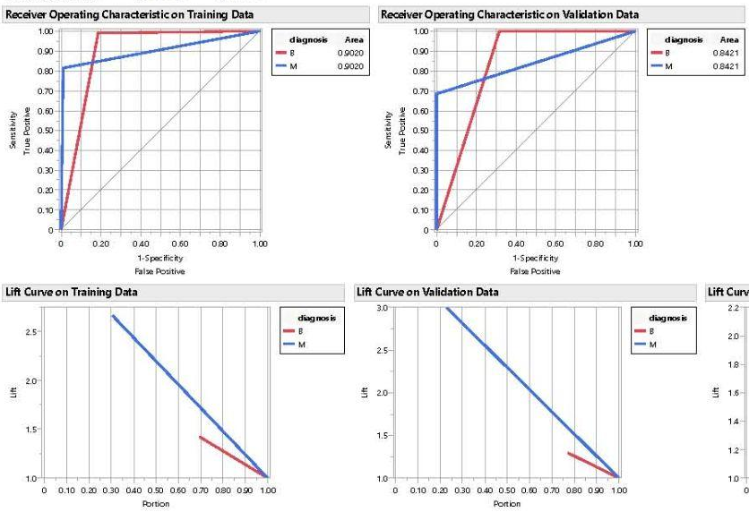
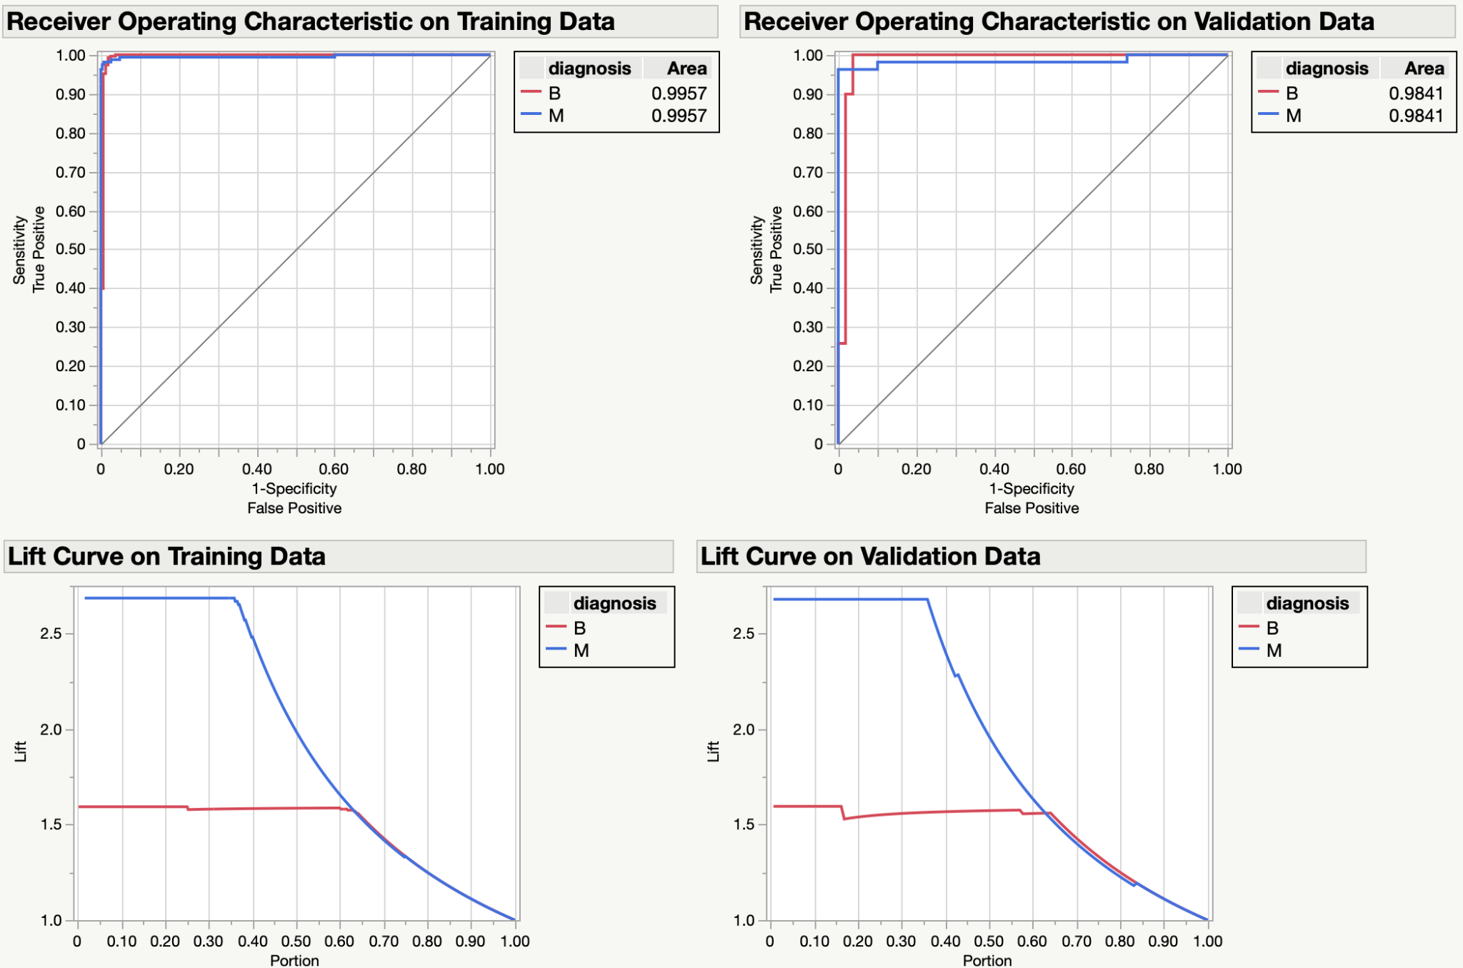
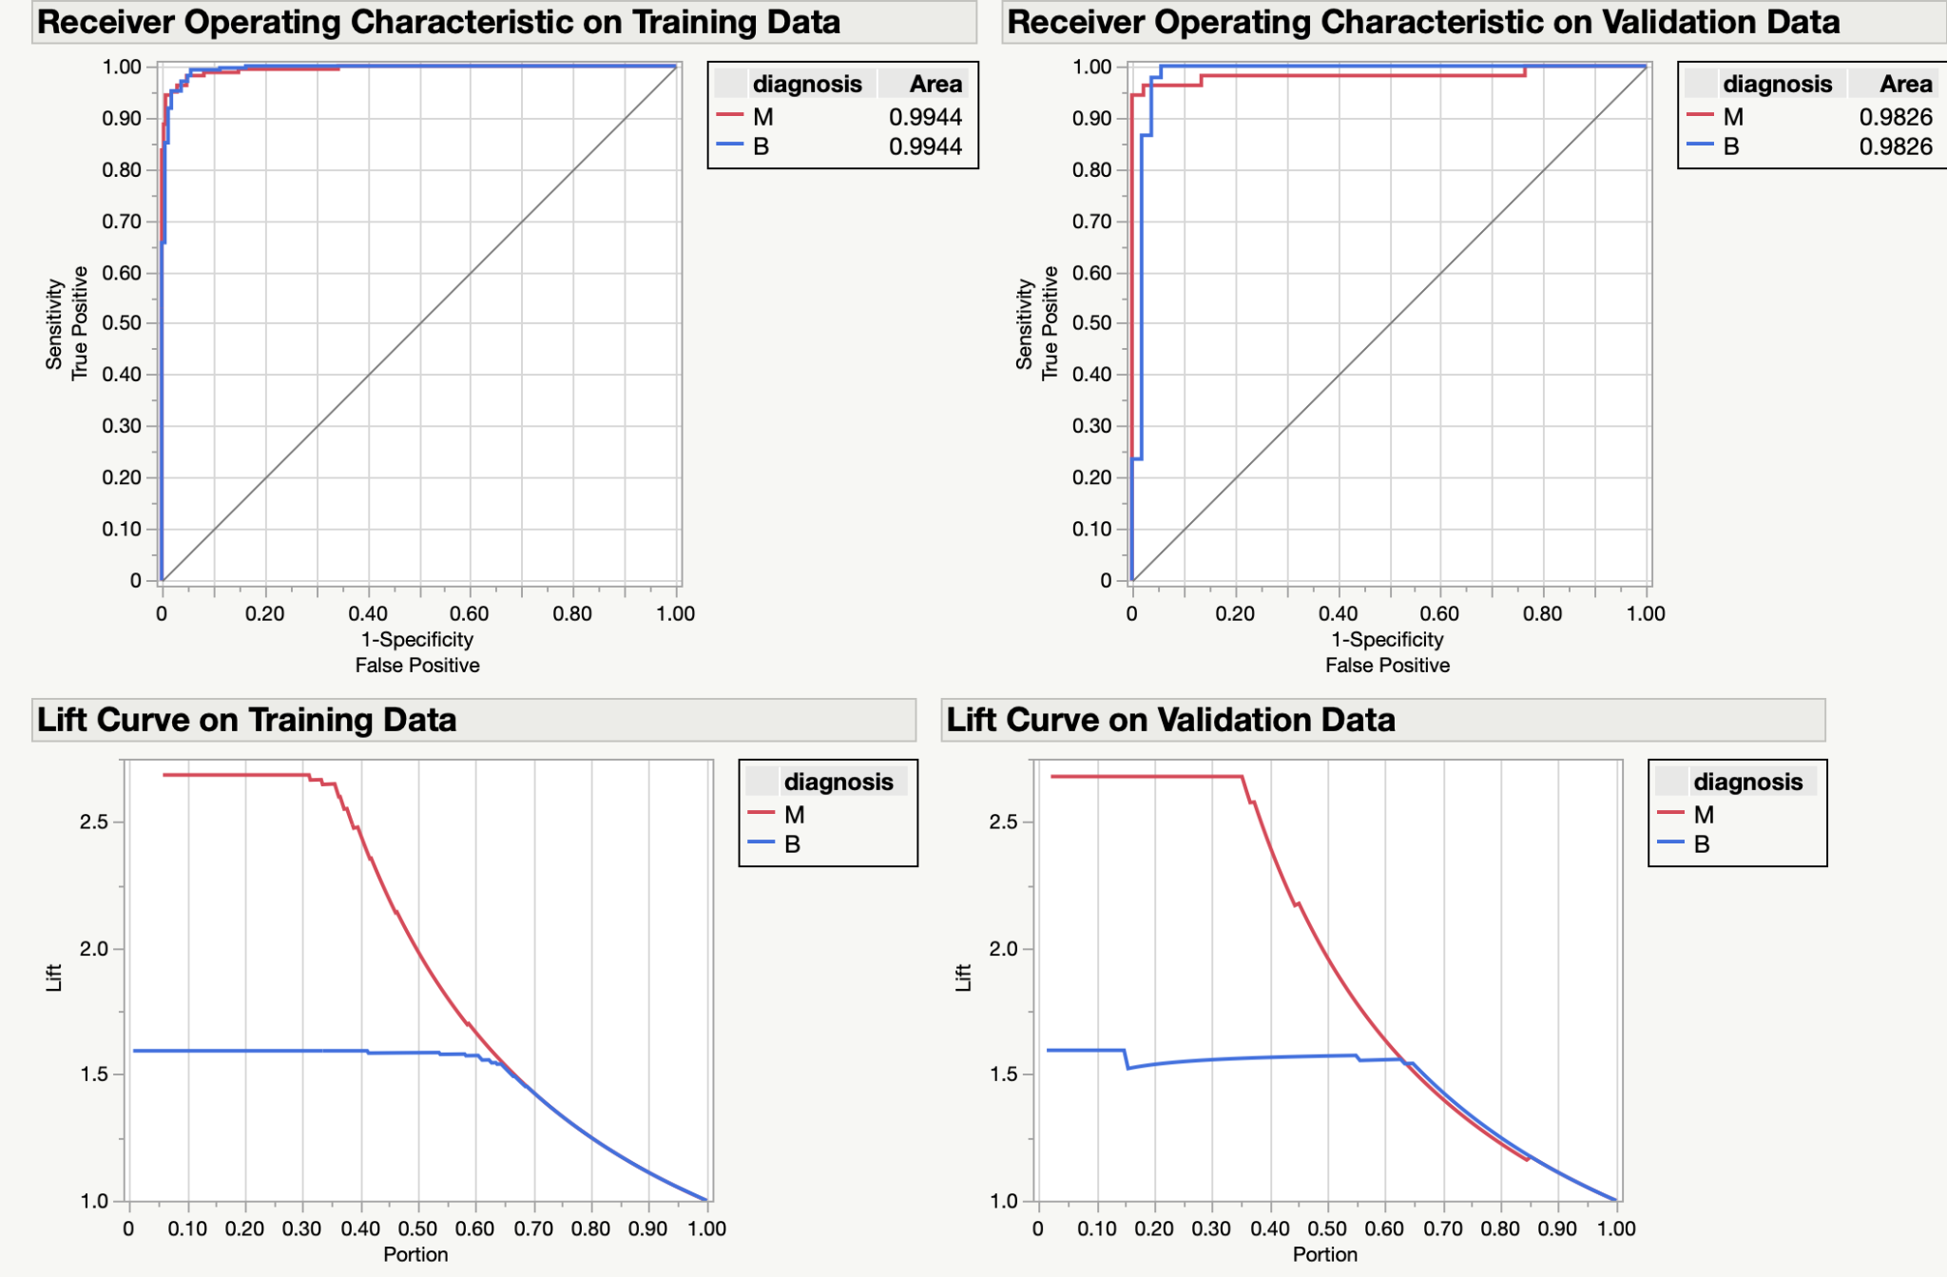

Other Models Built - Results
Decision Tree
Neural Network
Principal Component Analysis
Notes:
For the decision tree, neural network, and principal component analysis models, the ROC and lift curve charts can be used to compare performance. Both the neural network and principal component analysis models performed better than the decision tree model. The ROC chart lines are closer to (0,1) which represents a perfect model.

Slide 11

Models Built - Results Summary
 | # Vars | R^2 | AICc | BIC | RASE
Initial Baseline - Logistic | 30 | 1.0000 | 65.6946 | 196.66
Subsequent Baseline - Logistic | 20 | 0.9472 | 75.7003 | 160.093
Stepwise Logistic | 7 | 0.9382 | 53.2708 | 85.9103
Decision Tree |  | 0.6529 |  |  | 0.3035
Neural Network |  | 0.9294043 |  |  | 0.1254139
Principal Component Analysis | 4 components | 0.8711 | 82.8442 | 102.986
Notes:
The table shows a summary of the model fit details of the models. The logistic regression and neural network models performed the best as they have the highest R^2 values, and lowest AIC, BIC and RASE values. The lower the AIC, BIC and RASE values, the better since AIC penalizes models with more parameters, lower BIC values indicate a better model fit, and a lower RASE value indicates the error value magnitude.

Slide 12

Conclusion
Best models: logistic regression and neural network
Results: Significant correlation in tumor measurements and benign or malignant diagnosis.
Next Step: Further analysis should be done to incorporate other measures to aid in catching malignant masses early as possible.
Notes:
In conclusion, the logistic regression and neural network models had the best performance in accurately diagnosing breast cancer masses. Tumor measurements do have an impact on if the tumor is benign or malignant. These results mean that a model can be used to catch breast cancer in males and females early on. The next step in this analysis process would be to search for other measures that could help refine a model to a 99% success rate to save as many lives as possible.

